Slide 1
The Buggers’ Dilemma:
Eavesdroping and Traceback on the Internet
Geoff Huston
Chief Scientist
APNIC

Slide 2
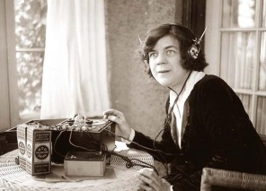
Eavesdropping in the Telephony World
Telephony is a network-centric architecture
The network is aware of the address and location of attached endpoints
Traffic is in the clear
Interception and eavesdropping can be performed as a network operation

Slide 3
Eavesdropping in the Telephony World
Internet
The Internet
Telephony is a network-centric architecture
The network is aware of the address and location of attached endpoints
Traffic is in the clear
Interception and eavesdropping can be performed as a network operation
The Internet is just a telephone network for computers.
Everything else remains the same! Right?

Slide 4
Internet Eavesdropping – 80’s–90’s
Modem tap to tape recorder to modem to transcript
Switches with eavesdrop port
Routers with eavesdrop port
Data was in the clear, IP addresses were static, and eavesdropping was a case of performing a binary decode of the data stream

Slide 5
Internet Eavesdropping – 80’s–90’s
Modem tap to tape recorder to modem to transcript
Switches with eavesdrop port
Routers with eavesdrop port
Data was in the clear, IP addresses were static, and eavesdropping was a case of performing a binary decode of the data stream
The Internet is just a telephone network for computers.
Everything else remains the same! Right?

Slide 6
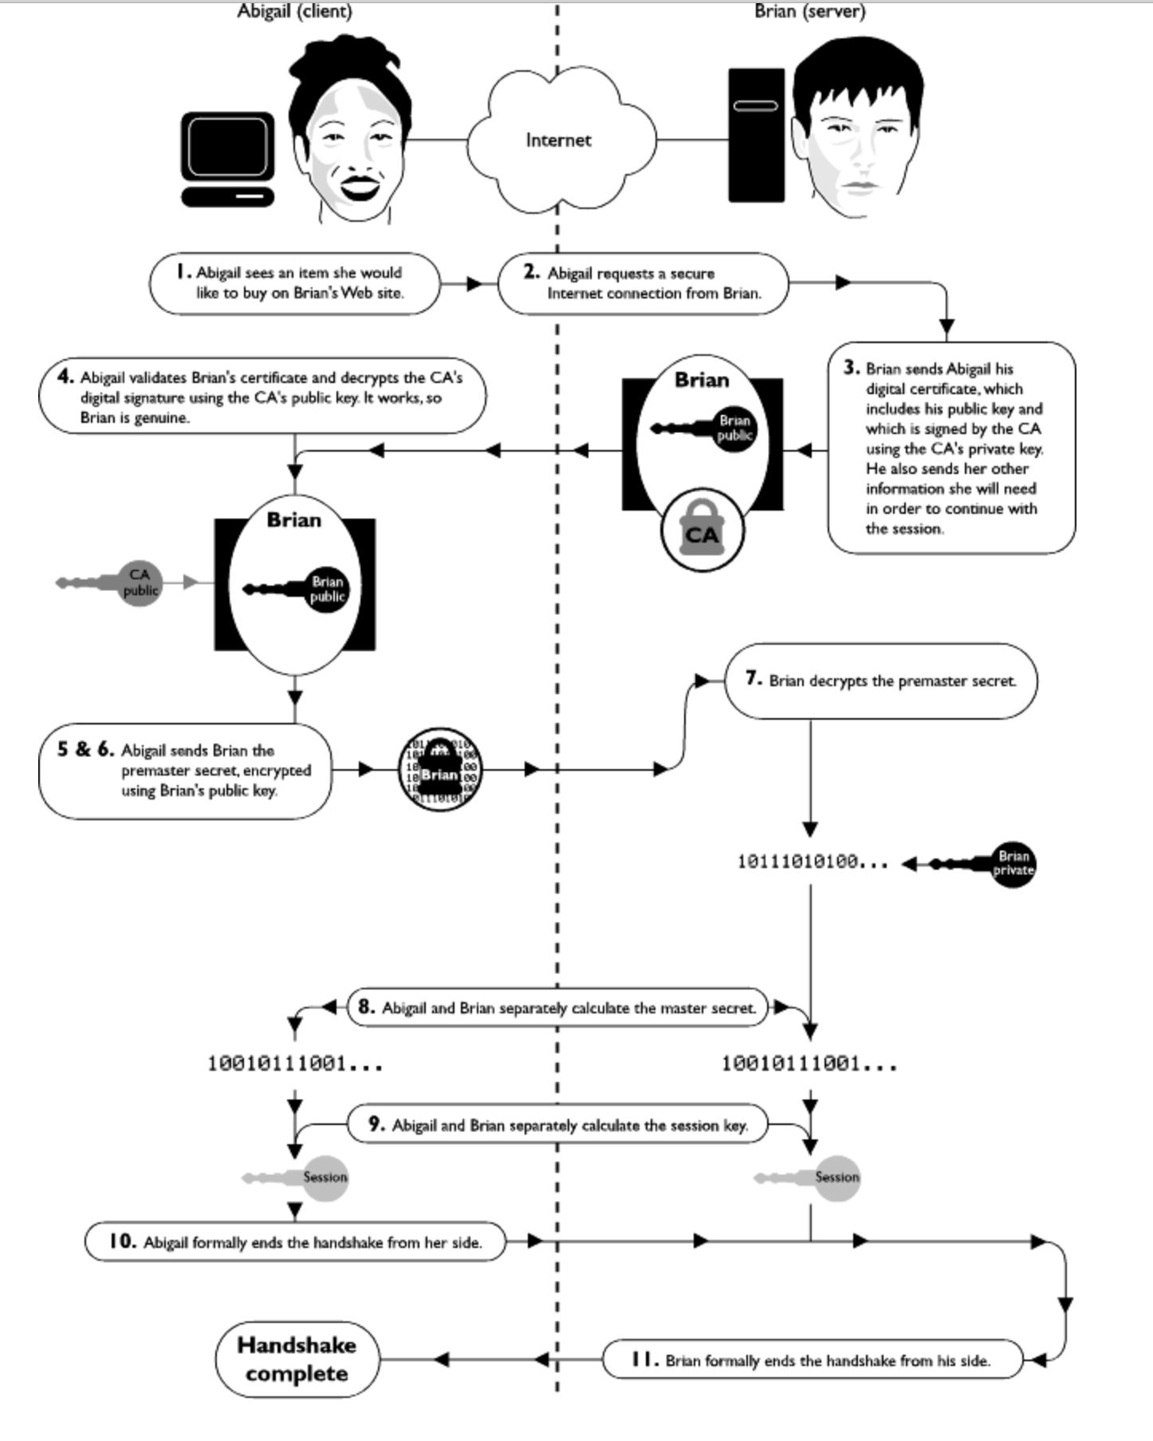
Encryption becomes a service
With the introduction of
“Secure Sockets” in the mid-1990s it was feasible for services to encrypt their sessions
But this was not for everyone – it required money and tech knowledge

Slide 7
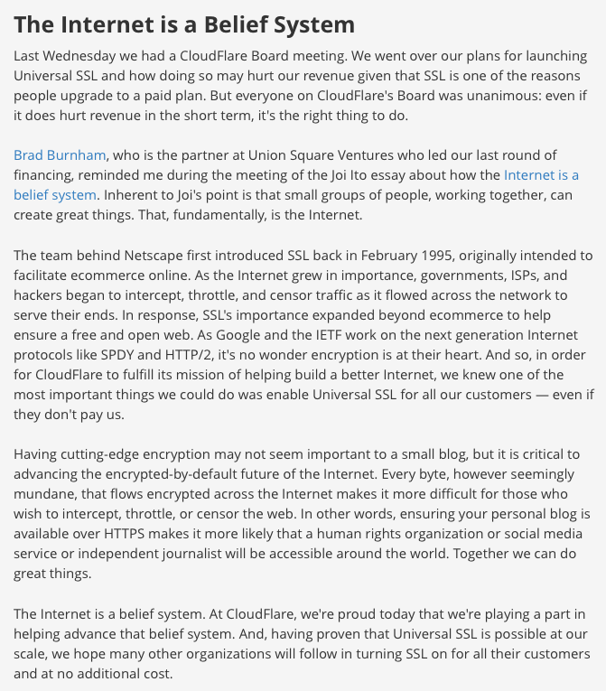
2014 - https://blog.cloudflare.com/introducing-universal-ssl/

Slide 8
But over time what’s expensive becomes cheap and universally available
2014 - https://blog.cloudflare.com/introducing-universal-ssl/

Slide 9
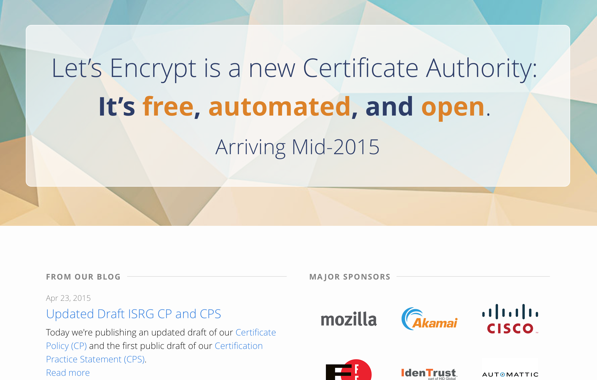
Lets ALL Encrypt!

Slide 10
Good Security is Relative
For traffic encryption for you and I the aim is to make it expensive for the eavesdropper
  So the compromise between efficiency and protective strength tends towards the adequate as distinct from the ideal
The aim of universal encryption is to increase the cost to the eavesdropper to the point where general surveillance is not affordable

Slide 11
Defense is expensive
The defender has to defend everything, the attacker only needs to exploit just one vulnerability…

Slide 12
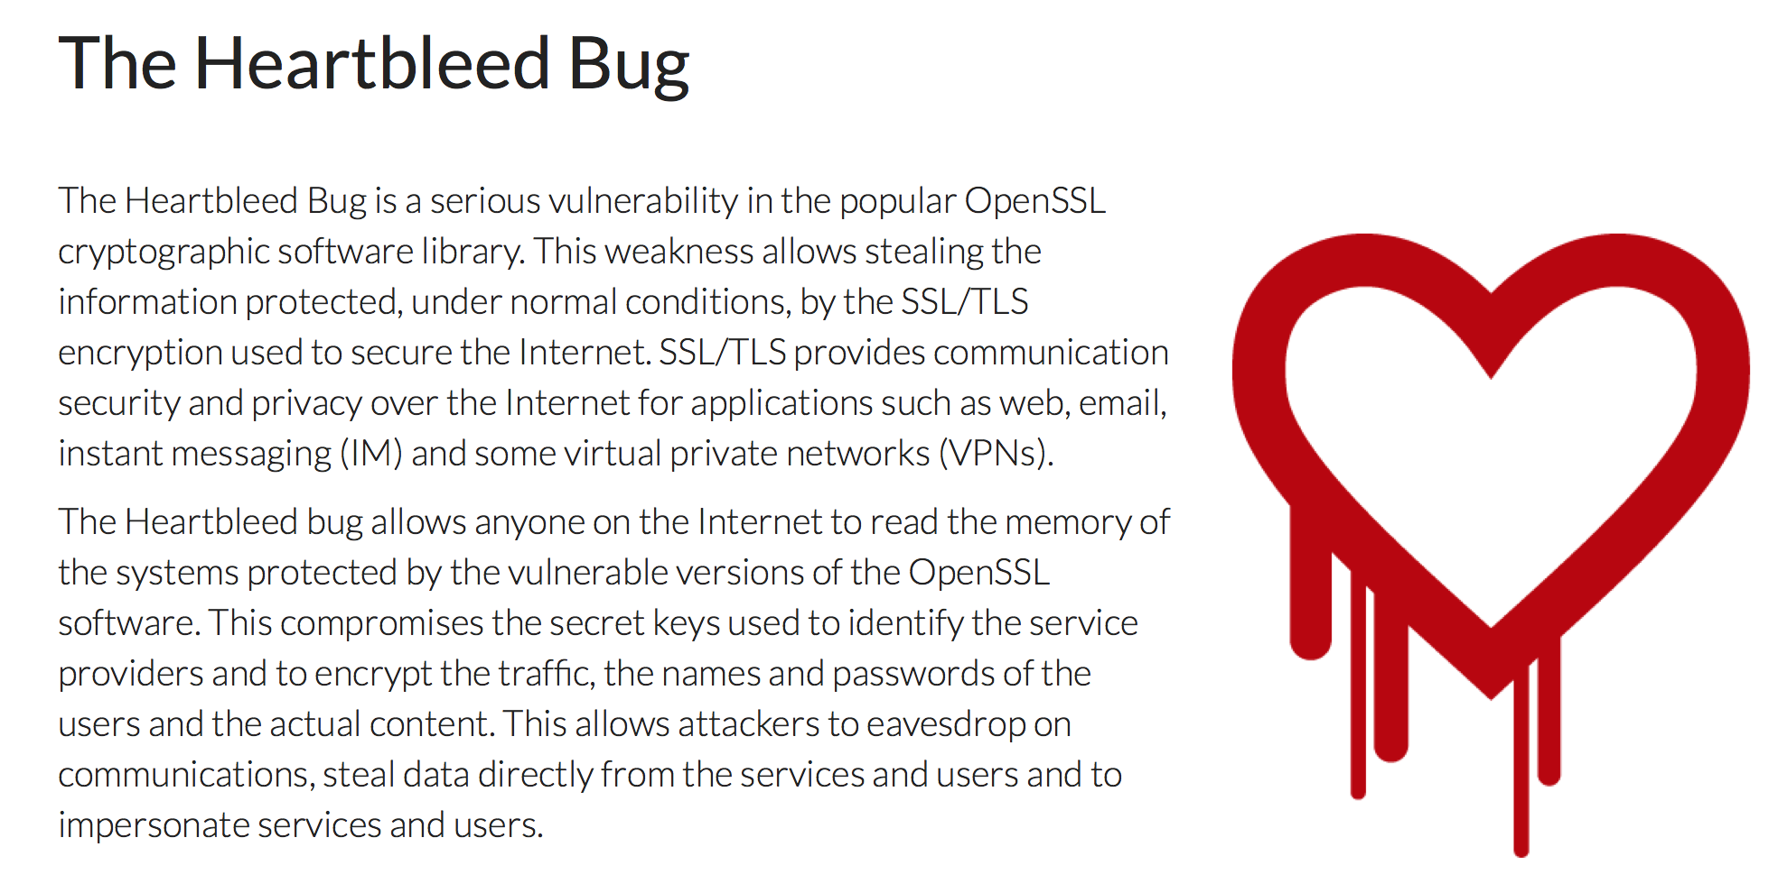
Heartbleed

Slide 13
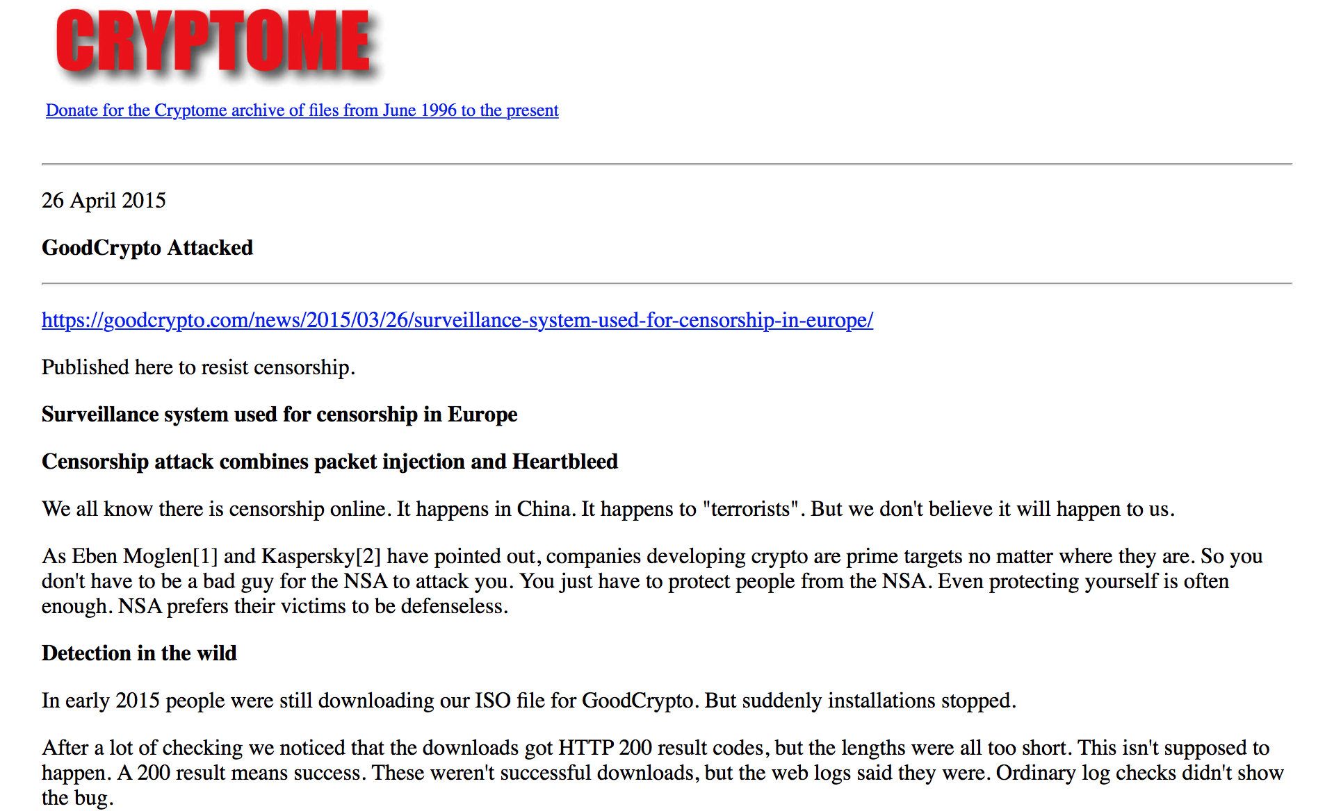
The bug that keeps on giving

Slide 14
The bug that keeps on giving
MITM attack in the UK using key compromise by exploiting Heartbleed vulnerabilities on the client’s side and
presumably applying the attack through
an interception appoach such as the UK’s “cleanfeed”

Slide 15
Who’s winning?
Pervasive security is a theme across much of the IETF’s current technology work:
  DNS: Secure DNS, qname minimization, client-resolver opportunistic encryption, DANE
  Addresses: Address PKI, Secure routing
  Transport: Opportunistic session encryption
The true capabilities and budgets of the security agencies are not clearly known:
  But the greater the take up of encryption and secure infrastructure the greater the cost and effort of surveillance

Slide 16
Who’s winning?
Pervasive security is a theme across much of the IETF’s current technology work:
  DNS: Secure DNS, qname minimization, client-resolver opportunistic encryption, DANE
  Addresses: Address PKI, Secure routing
  Transport: Opportunistic session encryption
The true capabilities and budgets of the security agencies are not clearly known:
  But the greater the take up of encryption and secure infrastructure the greater the cost and effort of surveillance
We think we are winning – we’re just not sure who “we” are, and what “winning” means!

Slide 17
After the fact
Traceback and forensics in today’s Internet

Slide 18
Traceback– Version 1
A: 192.0.2.1
Internet
Ftp Server
Lets start by looking waaaay back to the Internet of the 1980’s

Slide 19
Assumptions:
Each end site used a stable IP address range
Each address range was recorded in a registry, together with the end user data
Each end device was manually configured with a stable IP address
The networks uniformly route IP addresses
Traceback is keyed from the IP address

Slide 20
Traceback – Version 1
A: 192.0.2.1
Internet
Ftp Server
Ftp Server Log
ftpserver.net 192.0.2.1 [31/Aug/2013:00:00:08 +0000
$ whois 192.0.2.1
NetRange: 192.0.2.0 - 192.0.2.255
NetName: TEST-NET-1
Contact: User Contact Details
There was a rudimentary whois service and it listed all end users!

Slide 21
Assumptions:
Each end site used a stable IP address range
Each address range was recorded in a registry, together with the end user data
Each end device was manually configured with a stable IP address
The networks uniformly route IP addresses
Traceback is keyed from the IP address
This model largely fell into disuse by the late 1990’s
It was replaced by a combination of provider-address blocks, dynamic addressing to end users (AAA tools) and CPE NATs

Slide 22
+ NATs
A: 10.0.0.1
192.0.2.1
ISP
B: 10.0.0.2
CPE NAT/
DHCP Server
C: 10.0.0.3

Slide 23
Traceback – Version 2
A: 10.0.0.1
ISP
192.0.2.1
Web Server
CPE NAT/
DHCP Server

Slide 24
Traceback – Version 2
ISP RADIUS Log
15/Aug/2013:18:01:02: user XXX IP: 192.0.2.1
A: 10.0.0.1
ISP
192.0.2.1
Web Server
CPE NAT/
DHCP Server
Web Server Log
webserver.net 192.0.2.1 [31/Aug/2013:00:00:08 +0000] "GET /1x1.png HTTP/1.1" 200
$ whois 192.0.2.1
NetRange: 192.0.2.0 - 192.0.2.255
CIDR: 192.0.2.0/24
OriginAS:
NetName: TEST-NET-1
NetHandle: NET-192-0-2-0-1
Parent: NET-192-0-0-0-0
NetType: IANA Special Use

Slide 25
Assumptions
The ISP operates an address pool
Each end site is dynamically assigned a single IP address upon login (AAA)
The single public address is shared by the private devices through a CPE NAT
Traceback to an end site is keyed by an IP address and a date/time
Network data gets you to the CPE NAT, but no further

Slide 26
Assumptions
The ISP operates an address pool
Each end site is dynamically assigned a single IP address upon login (AAA)
The single public address is shared by the private devices through a CPE NAT
Traceback to an end site is keyed by an IP address and a date/time
Network logs get you to the CPE NAT, but no further
Individual devices are anonymous to the network. All that is visible to the network is the single shared address

Slide 27
Why?
Why are we sharing IP addresses between devices?
Surely there was nothing wrong with allowing each connected device to use its own dedicated address

Slide 28
IETF Meeting – August 1990

Slide 29
IETF Meeting – August 1990

Slide 30
IETF Meeting – August 1990
We were going to run out of addresses in 4 – 6 years!

Slide 31
The Response!
The short term
  Stop “wasting” addresses
The long term
  We need a new protocol

Slide 32
The Response!
The short term
  Stop “wasting” addresses
The long term
  We need a new protocol
Change the routing protocols to support variable host/net boundaries in addressing
Share IP addresses behind Network Address Translators
IPv6!

Slide 33
The Response!
The short term
  Stop “wasting” addresses
The long term
  We need a new protocol
Change the routing protocols to support variable host/net boundaries in addressing -- implemented by March 1993
Share IP addresses behind Network Address Translators
-- implemented by early 1994
IPv6!

Slide 34
The IPv6 Transition Plan - as planned
Size of the Internet
IPv6 Deployment
IPv6 Transition – Dual Stack
IPv4 Pool Size
Time
For this to work we have to start early and finish BEFORE IPv4 address pool exhaustion

Slide 35
The IPv6 Transition Plan - as implemented
Size of the Internet
IPv6 Transition – Dual Stack
IPv4 Pool Size
IPv6 Deployment?
2006
2008
2010
2012
2014
Date

Slide 36
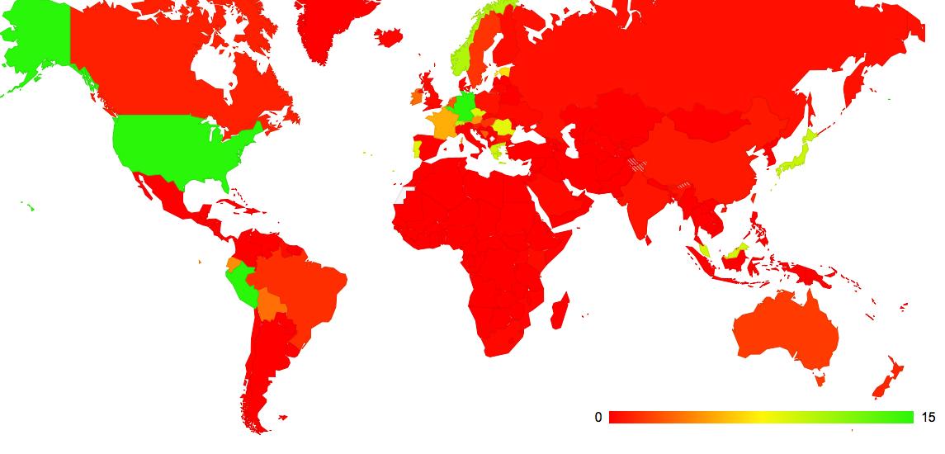
Where’s IPv6 Today?

Slide 37
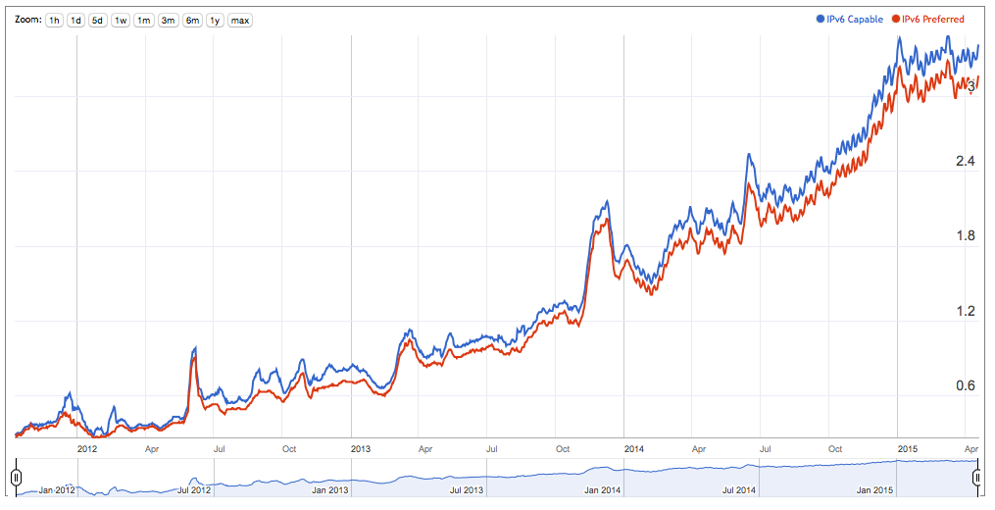
How much is IPv6 Today?
3.5% of the Internet’s 3 billion users
can use IPv6 today

Slide 38
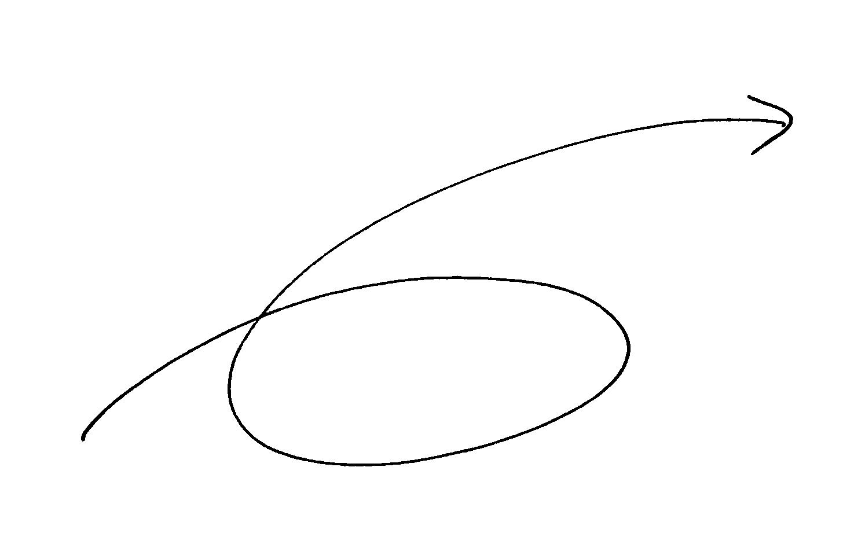

To get from “here” to “there” requires an excursion through an environment of CGNs, CDNs, ALGs and similar middleware ‘solutions’ to IPv4 address exhaustion
Running on Empty
IPv6
CGNs
IPv4
ALGs
CDNs

Slide 39
IPv4 Address Exhaustion
What are ISP’s doing in response?
  It’s not viable to switch over to IPv6 yet
  But the supply of further IPv4 addresses to fuel service platform growth has dried up
  How will ISPs continue to offer services to customers in the interim?

Slide 40
CGNs…
What we are seeing is the increasing use of address sharing using Carrier Grade NATs as a means of extending the useable life of the IPv4 Internet while we are still waiting for IPv6 to be viable in its own right
This has some significant implications for LEA functions, principally in traceback and ISP meta-data record keeping practices

Slide 41
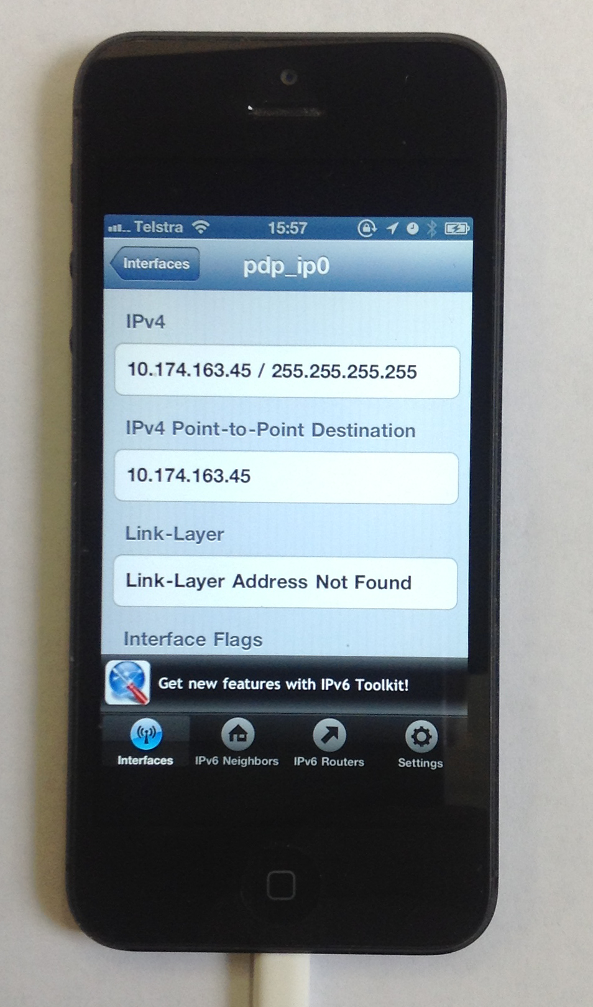
Carrier Grade NATs
By sharing public IPv4 addresses across multiple customers!
Yes, that’s my phone using net 10!

Slide 42
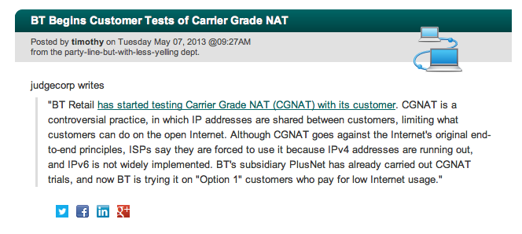
Carrier Grade NATs
By sharing public IPv4 addresses across multiple customers!
http://tech.slashdot.org/story/13/05/07/1232234/bt-begins-customer-tests-of-carrier-grade-nat

Slide 43
NATs + CGNs
ISP CGN
A: 192.168.1.10
B: 192.168.1.12
CPE NAT/
DHCP Server
C: 192.168.1.15
End User Private Address Pool
ISP Private Address Pool
Public Address Pool

Slide 44
NATs + CGNs + Connections
ISP CGN
A: 192.168.1.10
192.0.2.0/24
172.16.5.6
Internet
B: 192.168.1.12
CPE NAT/
DHCP Server
Web Server
C: 192.168.1.15

Slide 45
Assumptions
The ISP operates a public address pool and a private address pool
The access into the public address pool is via an ISP-operated NAT (CGN)
Each end site is dynamically assigned a single private IP address upon login (AAA)
The site is dynamically addressed using a private address range and a DHCP server
The single public address is shared by the private devices through a CPE NAT

Slide 46
Traceback – Version 3
ISP RADIUS Log
15/Aug/2013:18:01:02: user XXX IP: 172.16.5.6:34000-40000
ISP CGN
A: 192.168.1.10
192.0.2.0/24
172.16.5.6
Internet
B: 192.168.1.12
CPE NAT/
DHCP Server
Web Server
C: 192.168.1.15
ISP CGN Log
Web Server Log
31/Aug/2013:00:00:02
172.16.5.6:34233 128.66.0.0:80 -> 192.0.2.1:45800 128.66.0.0:80
webserver.net [192.0.2.1]::45800 [31/Aug/2013:00:00:08
+0000] "GET /1x1.png HTTP/1.1" 200
$ whois 192.0.2.1
NetRange: 192.0.2.0 - 192.0.2.255
CIDR: 192.0.2.0/24
OriginAS:
NetName: TEST-NET-1
NetHandle: NET-192-0-2-0-1
Parent: NET-192-0-0-0-0
NetType: IANA Special Use

Slide 47
Assumptions
Traceback to an end site is keyed by an IP address AND a port address, AND a date/time (uSec!)
  Requires access to:
    WHOIS records to identify the ISP,
    the ISP’s CGN logs to identify the ISP’s private address, and
    the ISP’s AAA logs to identify the end site

Slide 48
Assumptions
Traceback to an end site is keyed by an IP address AND a port address, AND a date/time (uSec!)
  Requires access to:
    WHOIS records to identify the ISP,
    the ISP’s CGN logs to identify the ISP’s private address, and
    the ISP’s AAA logs to identify the end site
Nobody logs this!

Slide 49
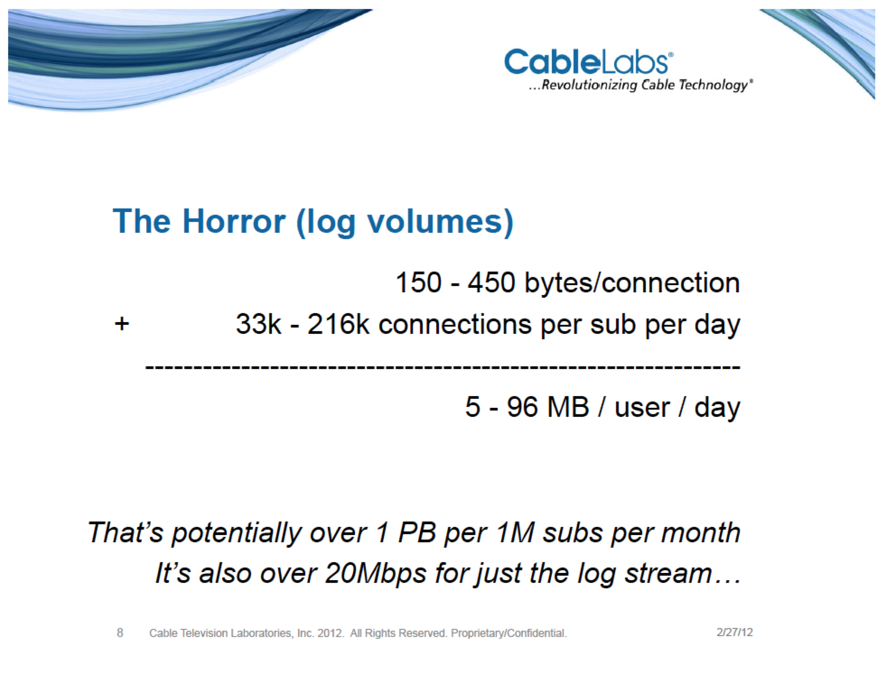
ISP CGN Logging
CGN bindings are formed for EVERY unique TCP and UDP session
That can be a LOT of data to retain…
http://www.nanog.org/meetings/nanog54/presentations/Tuesday/GrundemannLT.pdf

Slide 50
It could be better than this…
Use Port Blocks per customer
or
Use a mix of Port Blocks and Shared Port Pool overflow
and
Compress the log data (which will reduce storage but may increase search overhead)

Slide 51
Or it could be worse…

Slide 52
Challenges in Address Exhaustion:
This is a deregulated and highly
competitive environment
There is no plan, just the interplay of
various market pressures
2. Varying IPv4 Address Exhaustion Timelines
Differing time lines create differing
pressures in the market
3. Regional Diversity
One network architecture is not an
assured outcome!

Slide 53
What does this mean for the Internet?

Slide 54
What does this mean for the Internet?
We are going to see a LOT of transition middleware being deployed!

Slide 55
What does this mean for the Internet?
We are going to see a LOT of transition middleware being deployed!
And we are going to see a significant diversity in what that middleware does

Slide 56
What does this mean for LEAs?
LEAs have traditionally focused on the NETWORK as the point of interception and tracing
They are used to a consistent model to trace activity:
get an IP address and a time range
traceback based on these two values to uncover a set of network transactions

Slide 57
What does this mean for LEAs?
In a world of densely deployed CGNs and ALGS then the IP address loses any coherent meaning in terms of end party identification.

Slide 58
What does this mean for LEAs?
In a world of densely deployed CGNs and ALGS then the IP address loses any coherent meaning in terms of end party identification.
Today’s traceback approaches won’t work any more!

Slide 59
What does this mean for LEAs?
And instead of shifting to a single “new” model of IP address use, we are going to see widespread diversity in the use of transition mechanisms and NATs in carrier networks
Which implies that there will no longer be a useful single model of how to perform traceback on the network
Or even a single coherent model of “what is an IP address” in the network

Slide 60
Variants of NAT CGN Technologies
Address Compression
Ratio
10:1
100:1
1,000:1
>>10,000:1
Variant:
CGN with per-user port blocks
CGN with per-user port blocks + pooled overflow
CGN with pooled ports
CGN with 5-tuple binding maps
The same public address and port is used
simultaneously by multiple different internal
users
Customer A
Source: 192.0.2.1:1234
Dest: 128.66.0.0:80
ISP
Internet
Customer B
CGN
Source: 192.0.2.1:1234
Dest: 128.66.2.2:80

Slide 61
It gets worse …

Slide 62
Adding IPv6 to the CGN Mix
The space is not exclusively an IPv4 space.
While CGNs using all-IPv4 technologies are common today, we are also looking at how to use CGN variants a mix of IPv6 and IPv4
    For example: Dual-Stack Light connects IPv4 end users to the IPv4 Internet across an IPv6 ISP infrastructure.
We can expect to see many more variants of ISP’s address transform middleware when you are allowed to add IPv6 into the mix

Slide 63
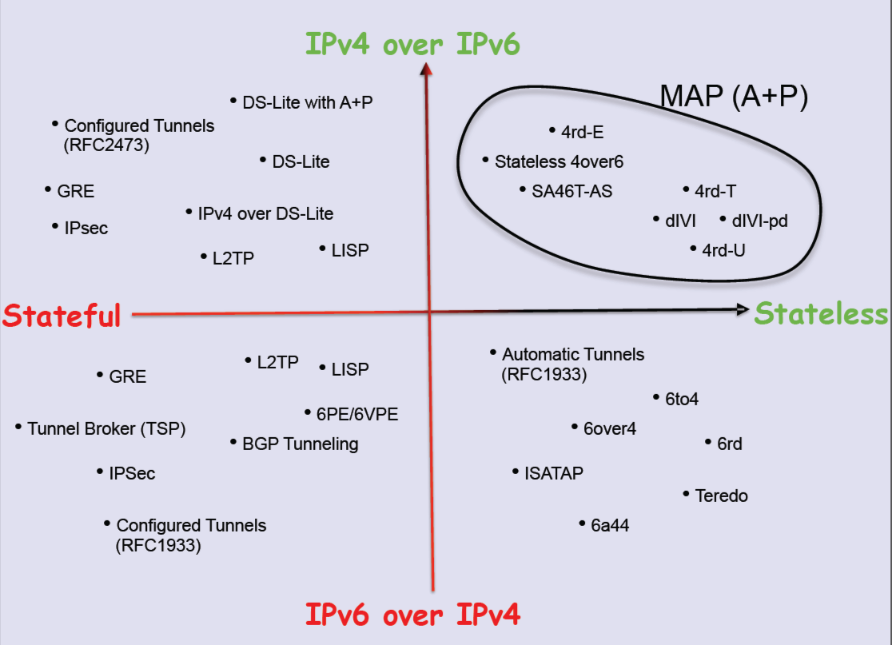
++IPv6:
Transition Technologies
Randy Bush, APPRICOT 2012: http://meetings.apnic.net/__data/assets/pdf_file/0016/45241/120229.apops-v4-life-extension.pdf

Slide 64
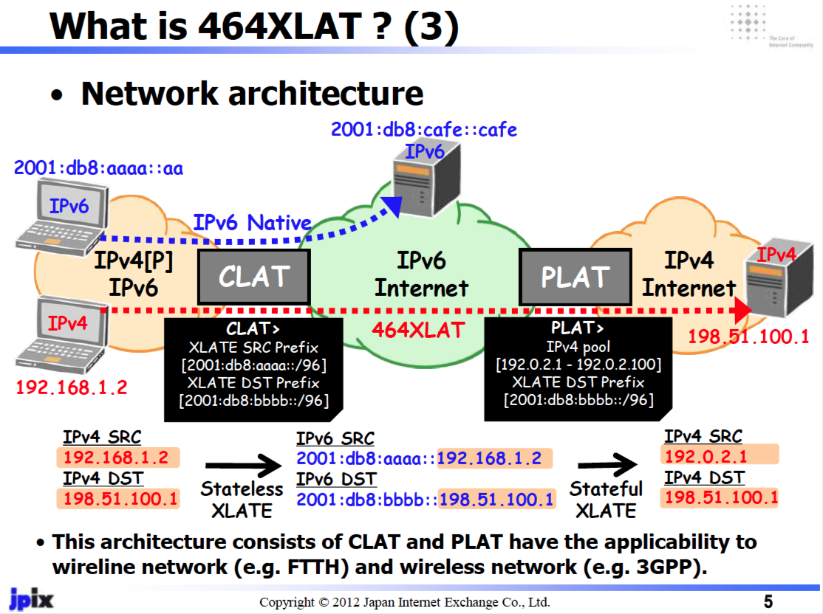
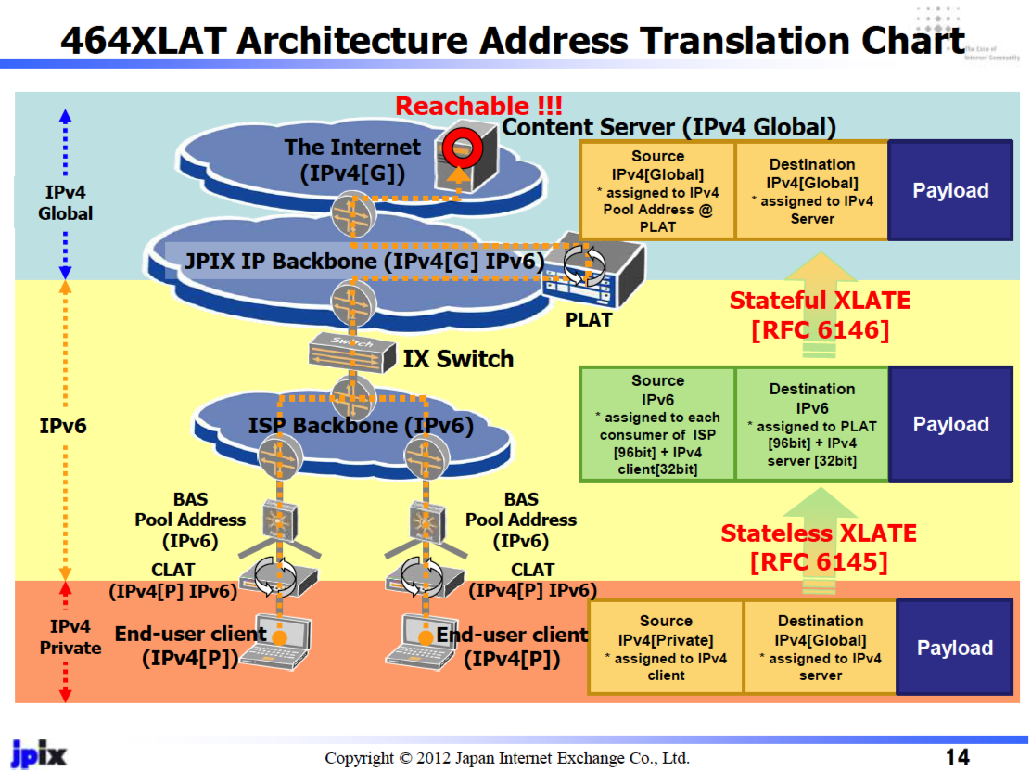
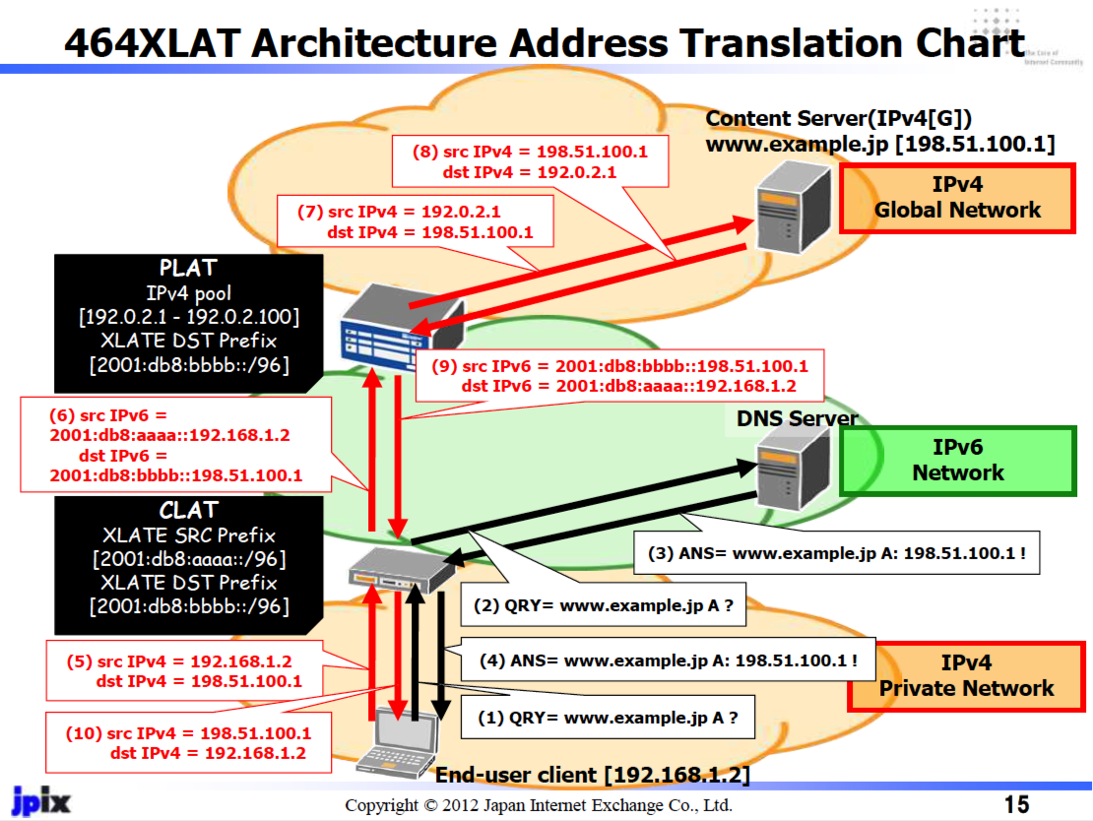
Transition Technologies Example: 464XLAT
Masataka Mawatari, Apricot 2012, http://meetings.apnic.net/__data/assets/pdf_file/0020/45542/jpix_464xlat_apricot2012_for_web.pdf

Slide 65
What does this mean for LEAs?
The risk we are running at the moment is that there is no longer be a single consistent model of how an IP network manages IPv4 and IPv6 addresses

Slide 66
What does this mean for LEAs?
What’s the likely response from LEAs and regulators?
One likely response is to augment the record keeping rules for ISPs:
    record absolutely everything, and keep the records for 2 years
    [Australian Data Retention, 2015]

Slide 67
What does this mean for ISPs and LEAs?
But what are the new record keeping rules?
In order to map a “external” IP address and time to a subscriber as part of a traceback exercise then:
  for every active middleware element you now need to hold the precise time and the precise transforms that were applied to a packet flow
  and you need to be able to cross-match these records accurately

Slide 68
What does this mean for ISPs and LEAs?
But what are the new record keeping rules?
In order to map a “external” IP address and time to a subscriber as part of a traceback exercise then:
  for every active middleware element you now need to hold the precise time and the precise transforms that were applied to a packet flow
  and you need to be able to cross-match these records accurately
Degree of difficulty -- approaching 10/10 !

Slide 69
What does this mean for ISPs and LEAs?
How many different sets of record keeping rules are required for each CGN / dual stack transition model being used?
And are these record keeping practices affordable?
  (granularity of the records is shifting from “session” records to “transition” and even individual packet records in this diverse model)
Are they even practical within today’s technology capability?
Is this scaleable?
Is it even useful any more?

Slide 70
Traceback in tommorrow’s Internet?
The traceback toolkit:
  precise time, source and dest IP addrs, protocol and port information
  Access to all ISP middleware logs
  CDN SP logs
  Network and Middleware deployment maps
  V6 Transition technology map used by the ISP
  A thorough understanding of vendor’s equipment behaviour for various applications
  A thorough understanding of application behaviours

Slide 71
Making it hard...
The V6 transition was challenging enough
The combination of V4 exhaustion and V6 transition is far harder
The combination of varying exhaustion times, widespread confusion, diverse agendas, diverse pressures, V4 exhaustion and V6 transition is now amazingly challenging

Slide 72
Making it very hard...
The problem we are facing is that we are heading away from a single service architecture in our IP networks
Different providers are seeing different pressures and opportunities, and are using different technology solutions in their networks
And the longer we sit in this “exhaustion + transitioning” world, the greater the diversity and internal complexity of service networks that will be deployed

Slide 73
“Toto, I've a feeling we're not in Kansas any more!”
Whois-land
All this will makes the entire record and trace problem for ISPs and LEAs harder
At some point along this path of escalating network complexity and diversity its likely that our networks will be simply be unable to traceback individual use in any coherent manner
If this is where the Internet is heading, then from an LEA perspective the tracking and tracing story is looking pretty bad

Slide 74
Does it ever get easier?
Is there light at the end of this tunnel?

Slide 75
The Transition to IPv6
Once we get to complete this transition we no longer need to use IPv4
Which means that we can throw aware these CGNs and their associated records
And the entire exercise of record keeping and traceback gets a whole lot easier

Slide 76
Traceback – IP Version 6
ISP
CPE
Web Server
Web Server Log
webserver.net 2001:db8:1:0:426c:8fff:fe35:45a8 [31/Aug/2013:00:00:08 +0000] "GET /1x1.png HTTP/1.1" 200
$ whois 2001:db8:1:0:426c:8fff:fe35:45a8
inet6num: 2001:0DB8::/32
netname: IPV6-DOC-AP
descr: IPv6 prefix for documentation purpose
country: AP

Slide 77
Traceback – IP Version 6
ISP AAA Log
15/Aug/2013:18:01:02: user XXX IP: 2001:db8:1::/56
2001:DB8:1::/56
ISP
CPE
Web Server
A: inet6: fe80::426c:8fff:fe35:45a8%en0
inet6: 2001:db8:1:0:426c:8fff:fe35:45a8
Web Server Log
webserver.net 2001:db8:1:0:426c:8fff:fe35:45a8 [31/Aug/2013:00:00:08 +0000] "GET /1x1.png HTTP/1.1" 200
$ whois 2001:db8:1:0:426c:8fff:fe35:45a8
inet6num: 2001:0DB8::/32
netname: IPV6-DOC-AP
descr: IPv6 prefix for documentation purpose
country: AP

Slide 78
IPv6 makes it easy again. Right?
Yes.
The semantics an IPv6 address in an IPv6 network are much the same as the original model of IPv4 addresses in a non-NATTed IPv4 Internet
Which is good.
But it’s not completely the same as the original IPv4 model…

Slide 79
IPv6 makes it easy again. Right?
mostly
IPv6 Privacy Addresses introduce ephemeral public IPv6 addresses into the mix
There are no logs of the privacy address, as it’s self assigned
  IPv6 Privacy addresses are used in Windows, Max OSx, some variants of Linux. We will see this in mobile networks as well in the coming months.
So IPv6 may not be able to track back to the device every time. Sometimes the best you can get is the home site and no closer!
As long as the /64 network address can trace to the end customer / mobile device then this will not be a critical problem – but the network’s address architecture is now a critical piece of knowledge

Slide 80
The Bottom Line
Compared to the byzantine complexities of the emerging CGN world of the IPv4 Internet, it certainly appears that an IPv6 Internet makes the conventional activities of record keeping and logging far easier once more
Typically, these IPv6 addresses will map all the way back to the MAC address of the device that is attached to the network
With IPv6 Privacy Addresses these address records do not necessarily resolve back to individual devices all the time, but they should give consistent visibility to the granularity of the home/end site network based on IPv6 address without massive record generation

Slide 81
Thank You!

