Slide 1
Addressing 2015
Geoff Huston
APNIC

Slide 2

The Addressing View

Slide 3
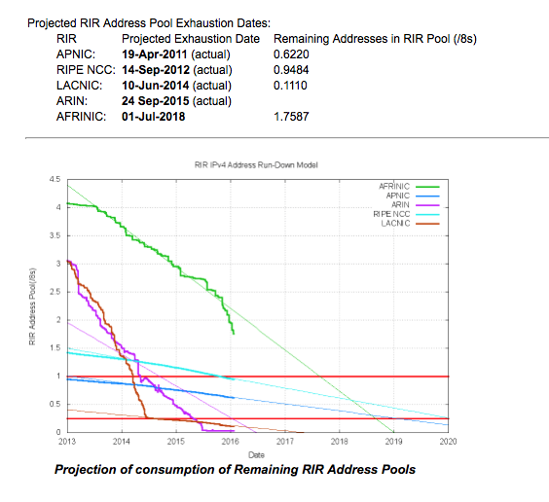
Addressing V4 Exhaustion
We have been predicting that the exhaustion of the free pool of IPv4 addresses would eventually happen for the past 25 years!
And, finally, we’ve now hit the bottom of the address pool!
  APNIC, RIPE NCC, LACNIC and ARIN are now empty of general use IPv4 addresses
  We now have just AFRINIC to go

Slide 4
Allocations in the Last Years of IPv4

Slide 5
Allocations in the Last Years of IPv4
Pre Exhaustion
Global Financial
Crisis
Exhaustion
Profile

Slide 6
Where did the Addresses Go?
Volume of Allocated IPv4 Addresses (using units of millions of /32s) per year
APNIC runs out
RIPE NCC runs out
LACNIC runs out
ARIN runs out

Slide 7
The IPv4 After-Market: Address Transfers
There is a considerable residual demand for IPv4 addresses following exhaustion
  IPv6 is not a direct substitute for the lack of IPv4
Some of this demand is pushed into using middleware that imposes address sharing (Carrier Grade NATS, Virtual Hosting, etc)
Where there is no substitute then we turn to the aftermarket
Some address transfers are “sale” transactions, and they are entered into the address registries
Some transfers take the form of “leases” where the lease holder’s details are not necessarily entered into the address registry

Slide 8
Address Transfers
Number of registered
Address transfers per year
Volume of addresses transferred
per year (millions of /32s p.a.)

Slide 9
Address Transfers
Number of registered
Address transfers per year
Volume of addresses transferred
per year (millions of /32s p.a.)
Movement of legacy addresses in 47/8 (to Microsoft) and 52/8 (to Amazon EC2)

Slide 10
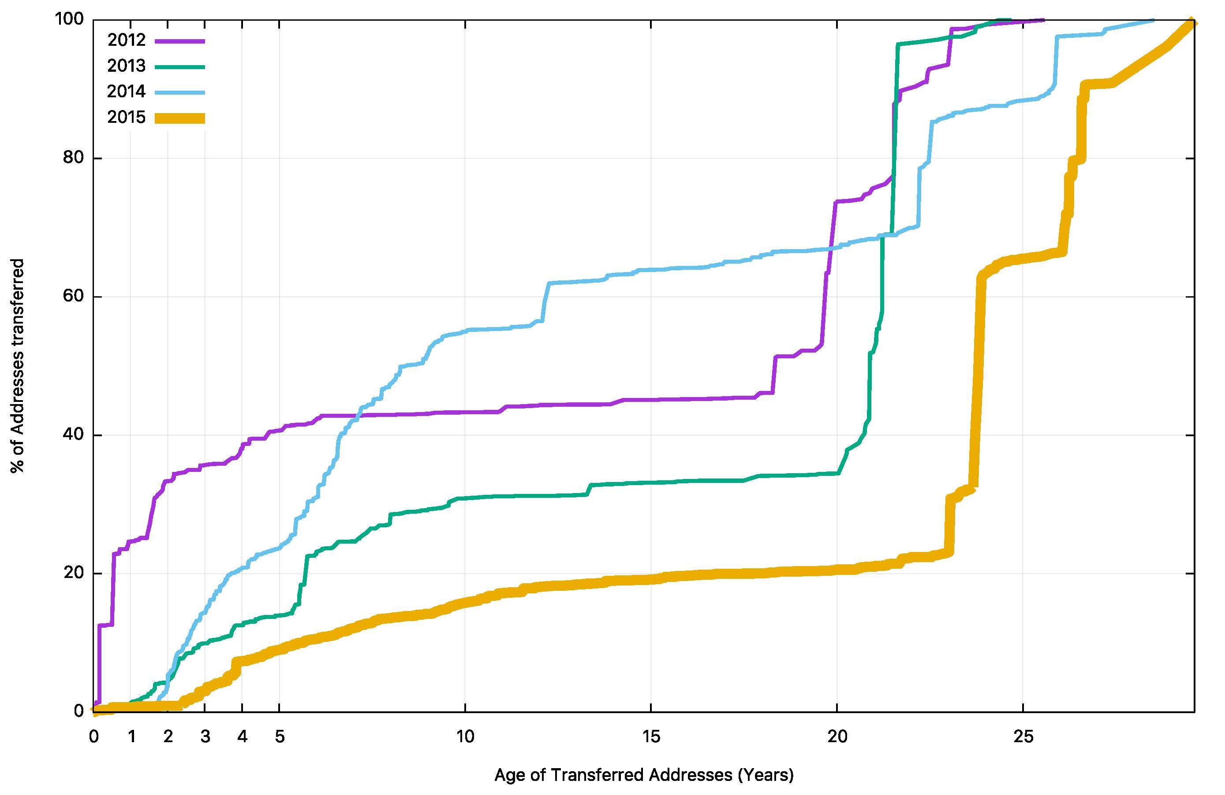
How old are transferred addresses?
80% of transferred addresses are >20 years old in 2015

Slide 11
IPv6 Allocations
Number of individual IPv6
address allocations per year

Slide 12
IPv6 Allocations
The allocation volumes are tapering off
Number of individual IPv6
address allocations per year

Slide 13
IPv6 Allocated Addresses
Volume of Allocated IPv6 Addresses (using units of /32s) per year

Slide 14
IPv6 Allocated Addresses
Volume of Allocated IPv6 Addresses (using units of /32s) per year

Slide 15
Where did the IPv6 addresses go?
Volume of Allocated IPv6 Addresses (using units of /32s) per country, per year

Slide 16
The Full Picture
What we don’t know is:
- the volume of unregistered address transfers
- the populations of devices using private addresses
located behind NATs

Slide 17

The Routing View

Slide 18
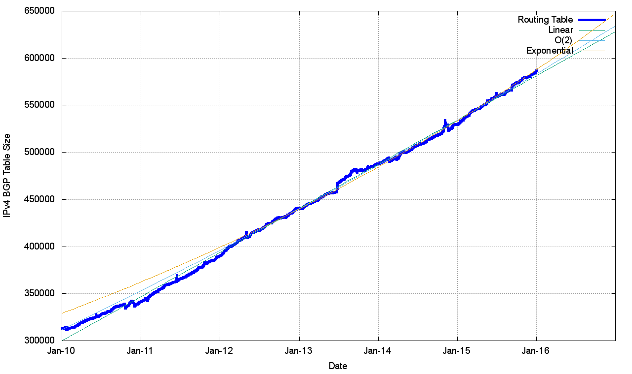
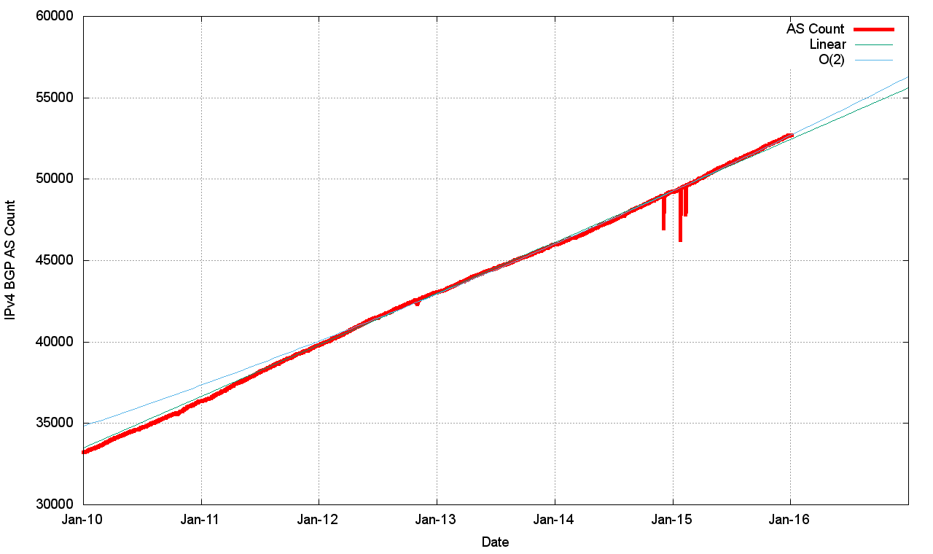
Routing Indicators for IPv4
Routing prefixes – growing by some 47,000 prefixes per year
AS Numbers– growing by some 3,100 prefixes per year

Slide 19
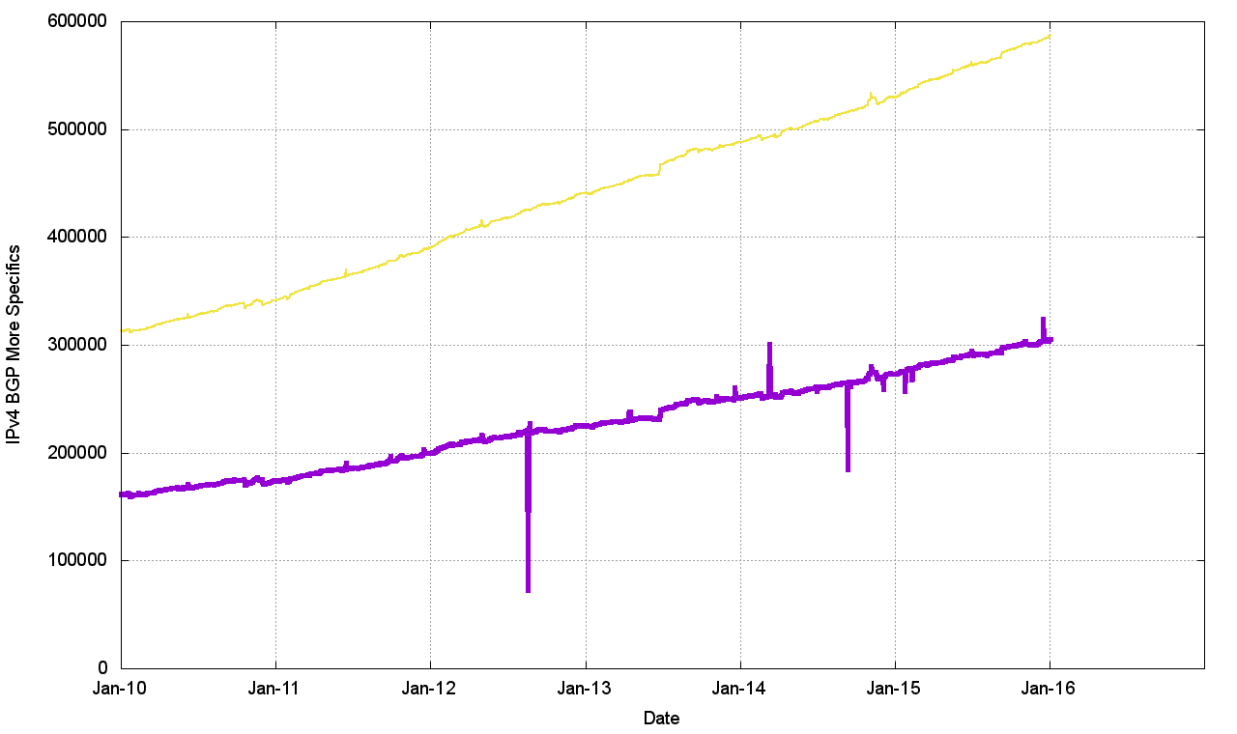
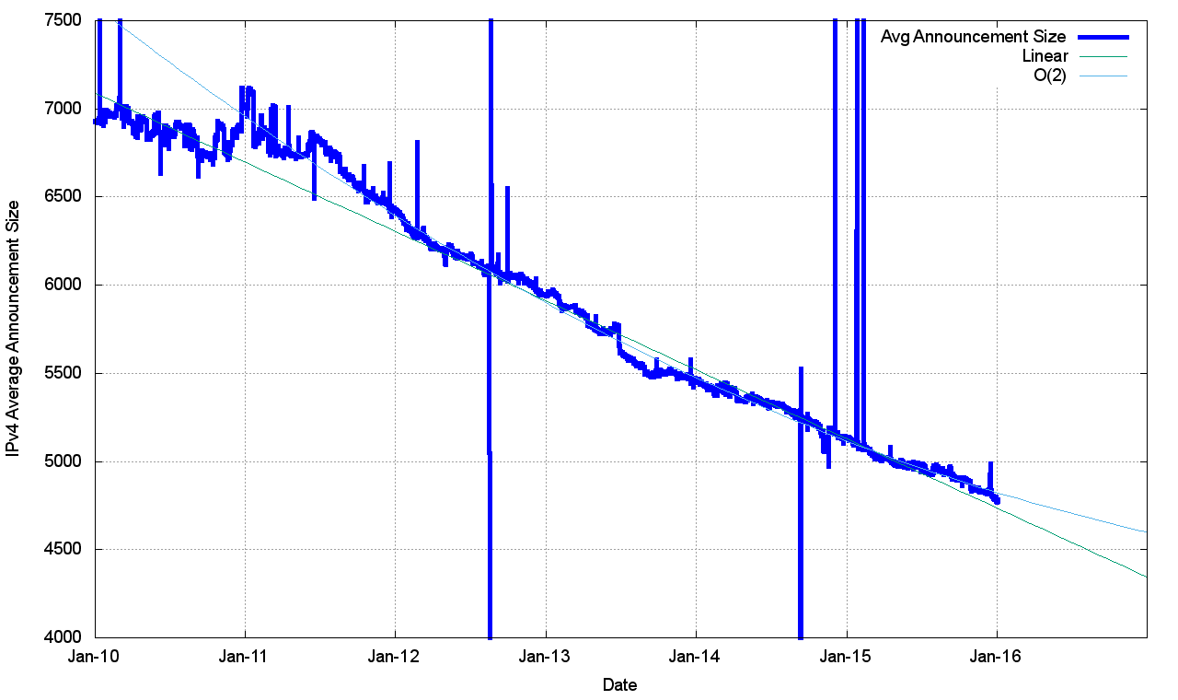
Routing Indicators for IPv4
More Specifics are still taking up one half of the routing table
But the average size of a routing advertisement is getting smaller

Slide 20
What happened in 2015 in V4?
From the look of the growth plots, its business as usual, despite the increasing pressure on IPv4 address availability
The number of entries in the default-free zone is now heading to 600,000
The pace of growth of the routing table is still relatively constant at ~50,000 new entries per year
  IPv4 address exhaustion is not changing this!

Slide 21
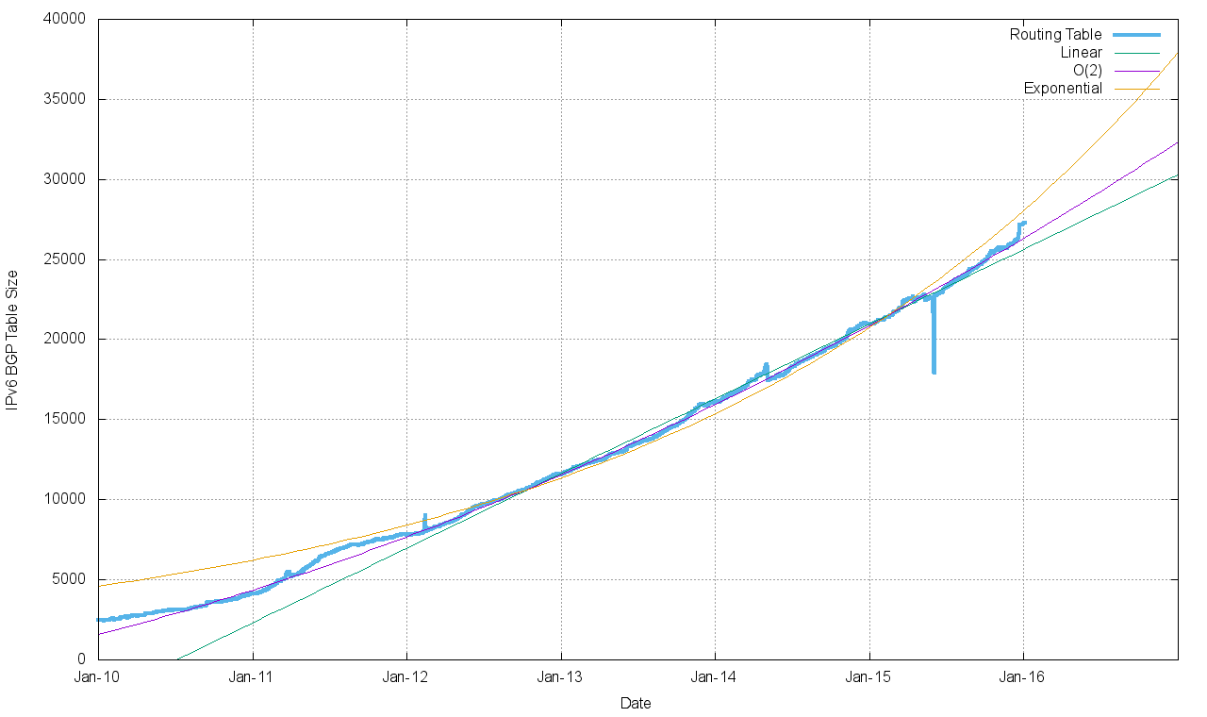
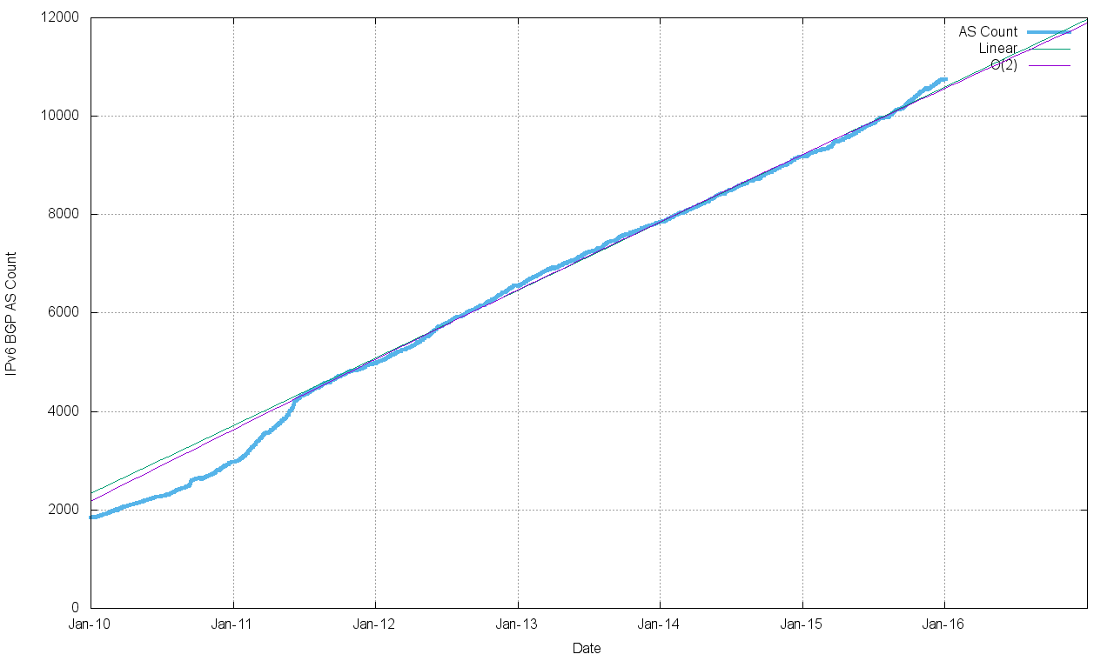
Routing Indicators for IPv6
Routing prefixes – growing by some 6,000 prefixes per year
AS Numbers– growing by some 1,600 prefixes per year

Slide 22
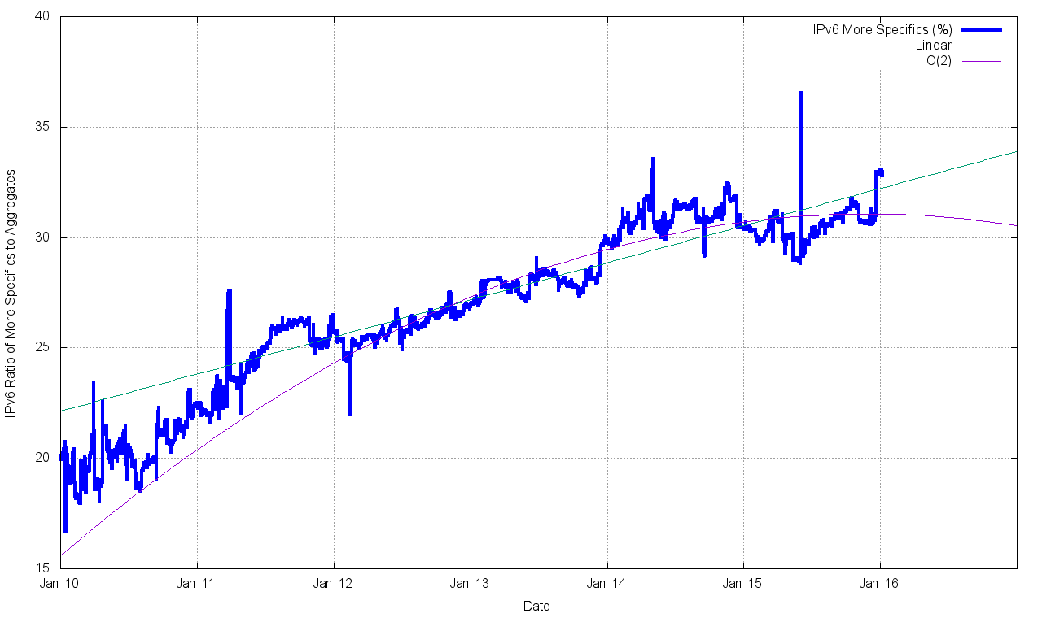
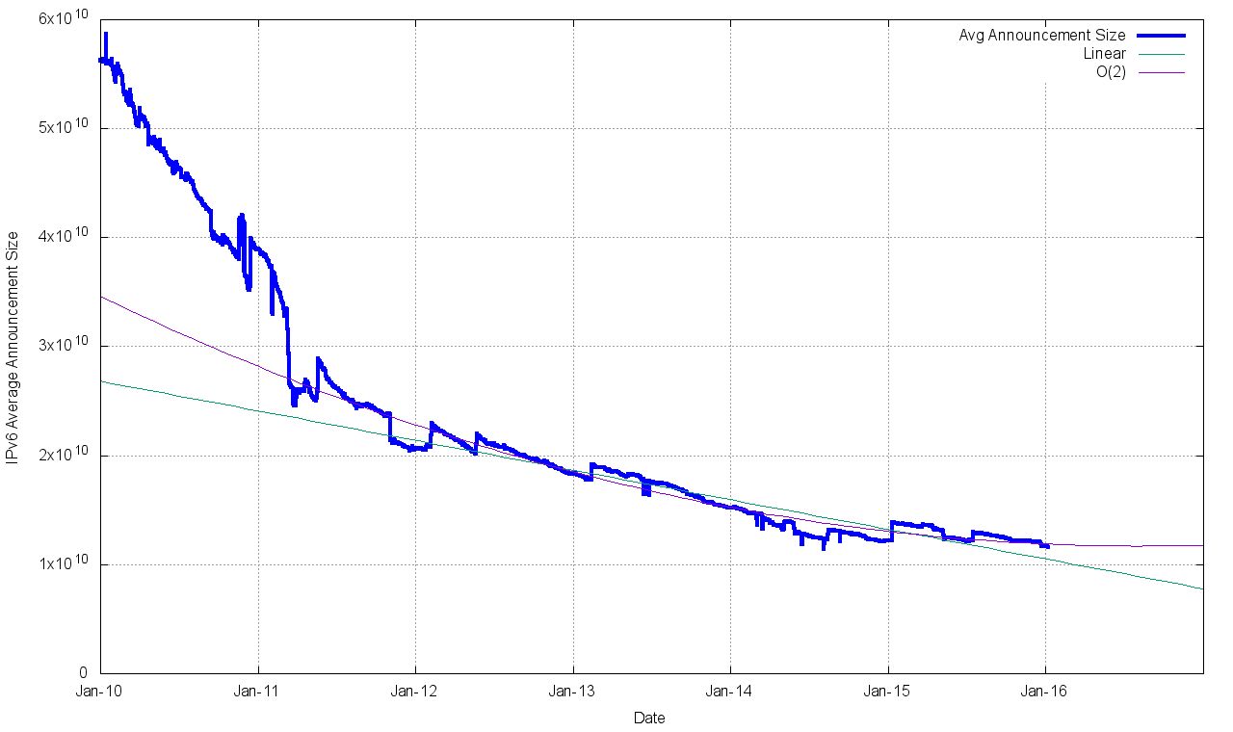
Routing Indicators for IPv6
More Specifics now take up one third of the routing table
The average size of a routing advertisement is getting smaller

Slide 23
Are we all now using V6?

Slide 24
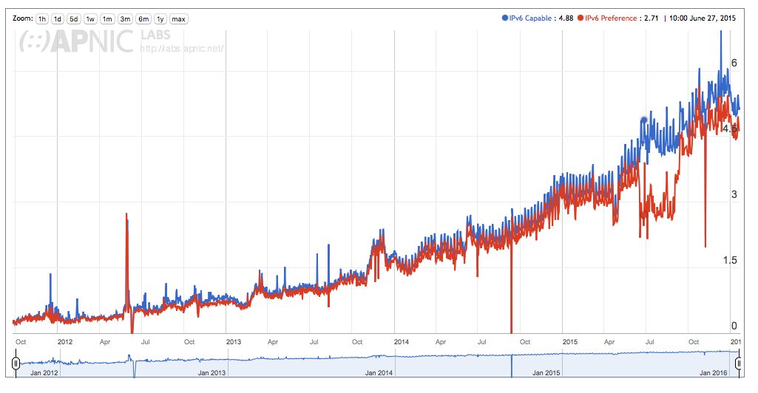
IPv6: How Many Can?

Slide 25
IPv6: How Many Can?
Weekend numbers are 0.4% higher then weekday numbers
0.2% of users prefer to use V4 in dual stack scenarios
IPv6 use has doubled across 2015

Slide 26
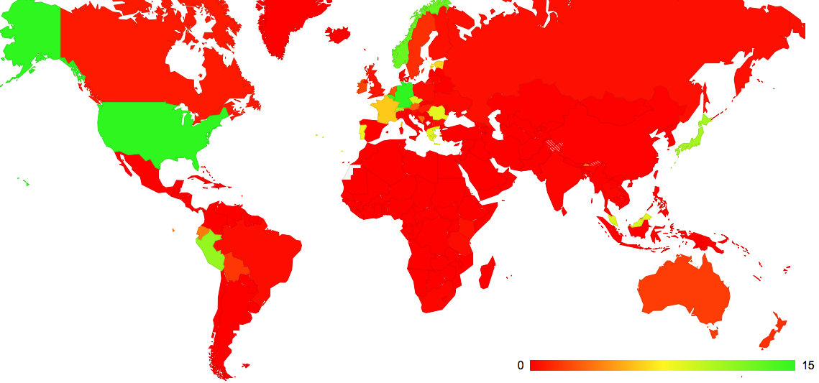
IPv6: Who Could?
IPv6 use by Country – February 2015

Slide 27
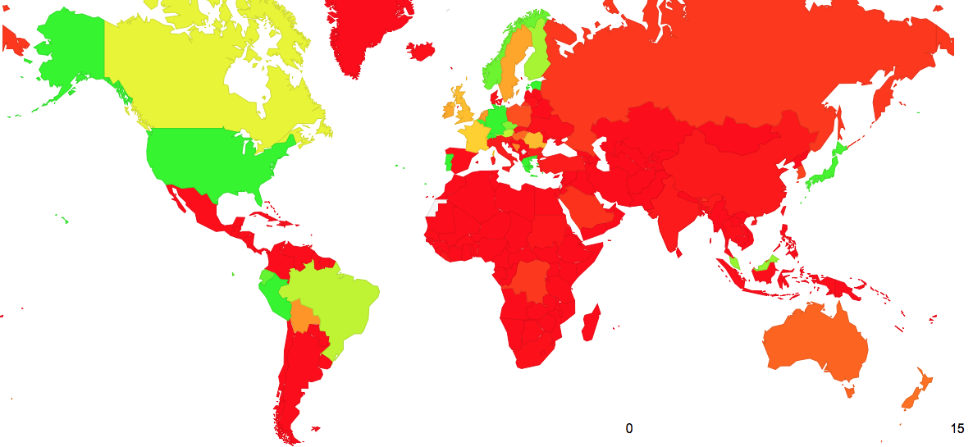
IPv6: Who Can?
IPv6 use by Country – January 2016

Slide 28
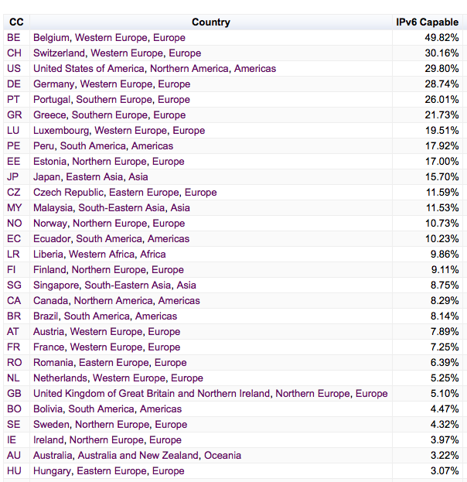
IPv6: Who Can?
IPv6 use by Country – January 2016
World Average

Slide 29
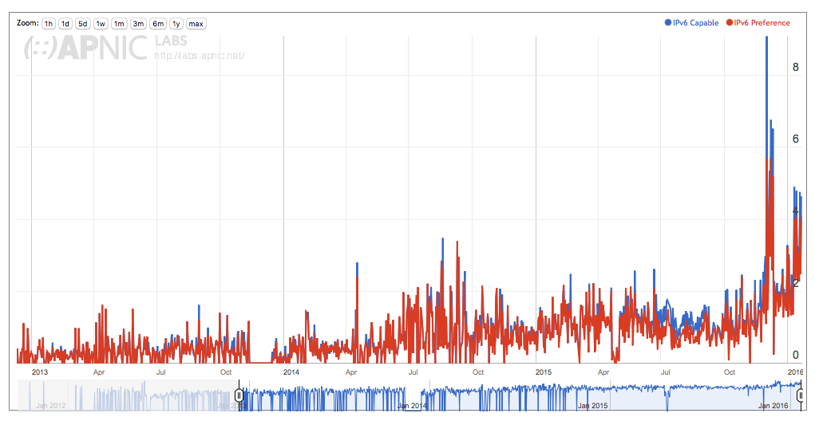
The Local View: New Zealand

Slide 30
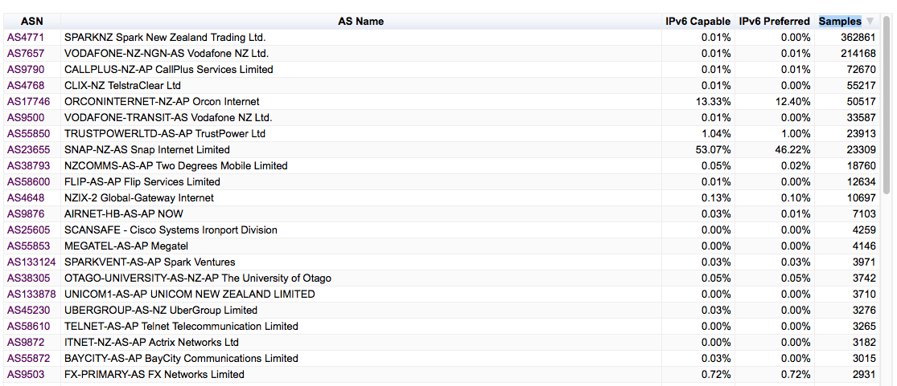
The Local View: New Zealand

Slide 31
Thank You

