Slide 1
Interconnection and Peering:
Then and Now
Geoff Huston
APNIC

Slide 2
Lets roll back the clock to 1998
And look at what was being said about interconnection, peering and exchanges 20 years ago

Slide 3


Slide 4

Interconnection Issues
Geoff Huston
Notes:
1
This presentation was formulated for the Internet Society's 1995 Workshop for Developing Countries, held in Honolulu, June 1995.
The topic covered is the architecture issues concerned with the development of national network infrastructures, focusing specifically on the issues involved with developing countries, the the issues involved with the establishment of such infrastructure activity. The presentation looks at this from a perspective of the architecture of such systems.
There are a number of non-technical issues which touch on policy formulation at a national level which enable such activity. These are briefly summarized at the end of the presentation.
It is noted that this presentation is not intended to be a specific "cookbook" for the design and implementation of a national Internet network service - this presentation will cover various aspects of this task in very general terms. In this task there is no universal "right" or "wrong" way to undertake such activity. The following are very much views derived from the personal experience of constructing a national network infrastructure within Australia over the period from 1989 until 1995, and the associated experience of working with the Internet environment globally over this same period. It is readily acknowledged that whatever attempts at "guidelines" that are proposed within this presentation will, necessarily, be extensively modified within the practical environment of a particular nation or region, and accordingly the author cautions any reader to view the following more as a set of personal observations rather than a more substantive set of objective and rigid principles.
Bio Notes:
This presentation was written by Geoff Huston, who is the Network Technical Manager of the Australian Academic and Research Network (AARNet). He is one of the co-chairs of the IEPG, the Internet Service Operators' forum, and is a participant within the IETF community. He is also a member of the Board of Trustees of the Internet Society, and is currently the Secretary of the Society.

Slide 5
Internet Service Providers
Many providers in every market
Many provider profiles - from small local business to global corporation
Many diverse objectives in entering the ISP market
  niche market opportunity
  leverage of core activities
  revenue opportunity
  capital gain opportunity
  risk dilution
Notes:
2
This presentation will treat the subject area within six broad areas -
- The definition of architectural principles for national network infrastructure
- The translation of such architectural principles into a design for a national network
- The generation of a specific engineering plan for the implementation and operation of the network service
- Implementation considerations
- Operational Considerations
- Some comments regarding the political environment of construction of national Internet services

Slide 6
The Financial Model of Interconnection
Transit is a customer / provider relationship where the customer ISP pays the provider (transit) ISP
Peering is a “Sender Keep All” relationship where neither ISP pays the other
These are the only models of Interconnection between ISPs in the Internet
Why?

Slide 7
Follow the Money
In a conventional multi-provider service the money flow is easy to identify. For example in the telephone network:
  John initiates the transaction
  John pays his local provider A for the entire end-to-end transaction charge for the end-to-end service
  A pays B an “interprovider charge” for B to terminate the transaction
  B terminates the transaction at Mary without charging Mary
A
B
John
Mary
A
B
John
Mary

Slide 8
Settlements - Who pays who?
The inter-provider financial relationship will vary for each individual transaction
The net outcome is balanced through financial settlement
Financial Settlement
A pays B
B pays A
$0 settlement point

Slide 9
Settlements- Who pays who?
This assumes:
  each transaction has a measurable value
  each transaction is individually accountable
  each transaction is funded by the end clients in a consistent fashion
    initiator direction pays or
    responder direction pays
There is no incentive for setting efficient inter-provider settlement rates in this model when the parties are operating as local monopolies

Slide 10
Enter the Internet . . .
In the Internet there is no readily identifiable uniform service transaction
  There is no “call” or similar compound service transaction
  There is no “caller” and no “recipient”
Customers pay their ISP to both send and receive IP packets on their behalf
What happens when customers in different network exchange packets?
Could we map each service transaction to the transit of a single packet (packet accounting)

Slide 11
IP Packet Accounting is a failure!
IP packets
  have a vanishingly small value
  have no readily identifiable transaction context
  may not be delivered
  have no ability to accumulate a uniform model of ‘incremental value’
Inter-Provider IP packet accounting models
  accrue benefits to inefficient carriers and penalise efficient carriers
  this is the opposite of what benefits consumers!

Slide 12
Can we drop per-service settlements?
The retail model of the Internet is an “access” service, not a usage service
  Customers are changed a flat fee for access to the Internet, rather than a charge per sent or received packet, or for variable fees based on the routes miles incurred by the packet
Any stable inter-provider connection model needs to be an abstraction of the retail model
  Otherwise the differences create opportunities for leverage which generates inefficiencies

Slide 13
Two Party Peering
In a simple case of two ISPs that have similar size, then each customer is meeting their ISPs costs incurred in carrying the packet
There is no net imbalance that calls for inter-provider financial settlement
$0
B pays
A pays
A
B

Slide 14
Two Party Tiering
When the two ISPs are of dissimilar size then peering will not be seen as fair, as the smaller ISP is leveraging the size of the larger
The typical outcome is for the smaller ISP to become a customer of the larger ISP
$0
A pays
B pays
A
B

Slide 15
Multi-Party Interconnection
The two ISP model can be generalised to multiple parties by using the same two concepts of:
  Customer/Provider, where the customer pays the provider
  Peering, where there is no financial settlement
Peering
B pays
A pays
Transit Provider
Customer
A
B
Customer
Customer

Slide 16
The Interconnection Model
Each ISP may have multiple relationships:
Providers
Peers
Customers

Slide 17
The Financial Interconnection Model
The financial flow in this model is extremely simple:
Customers pay to Providers
Providers receive payments from Customers
Peers don’t pay each other

Slide 18
The Routing Interconnection Model
The route advertisement flow in this model is extremely simple:
  Routes learned from customers are re-advertised to other customers, peers and upstreams
  Routes learned from Peers are re-advertised only to Customers
  Routes learned from upstreams are re-advertised only to Customers

Slide 19
Negotiated Relationships
Every ISP interconnection is either a relationship of provider/ customer or SKA peer
It’s up to the parties to reach an agreement between themselves
There are no fixed rules, so its possible to see interconnection as a market in its own right
  But there are informal “guidelines”

Slide 20
Universal Peering is a poor strategy
Unless you have nothing to lose!
Risks
  Leverage where a smaller ISP can leverage the network base of a larger ISP without paying
  Disincentive to invest when others can on-sell the network service without incurring the cost of service provision
Both parties have to perceive equal benefit in order to peer
  If unequal parties are forced to peer the larger party is placed at a commercial disadvantage
Notes:
15

Slide 21
Aggregation Wins
Every customer wants to be a peer
Every peer wants to be a provider
Bigger is better
  ISPs that aggregate through mergers and takeovers can obtain access to a more advantaged position with respect to their peer ISPs

Slide 22
The Internet - as we know it
The competitive ISP industry tends to equilibrate on the lowest local cost structures
There are no objective criteria to identify who is the provider and who is the customer
underlying carriage tariffs shape Internet-based ‘locality’
Within each locality ISPs tend to SKA peer - or not
  bluff is a critical component of the peering game
Strict tiering blurs because of the confusion over value identification
  is content of equal value to transit?

Slide 23
The Problem - as we see it
How to interconnect many component networks while:
  minimizing local cost everywhere by:
    localizing transit traffic
    matching diverse import, export and transit policies
    avoiding super dense traffic black holes
    maintaining stability and quality
      both technical and financial
    staying within the bounds of available technologies
    and also adding thousands more component networks

Slide 24
The Role of the Exchange
An examination of the rationale for public Internet exchanges

Slide 25
The N-squared problem
  N² circuits, N² peerings
  questionable scaling properties

Slide 26
The Exchange Router
    Simple unilateral exchange policy
    Router-based exchanges impose transit policy
Exchange Router selects preferred
path to destination A
A

Slide 27
The Exchange Switch
Exchange LAN Switch

Slide 28
The Exchange L2 Switch
Route Peer
Mesh
Bilateral peering allows
each ISP to select preferred
path to destination A
A
  An L2 switch does not implement routing policy
  Routing policy is then the outcome of bilateral agreements

Slide 29
The Distributed Exchange
Use of L2 virtual circuits to support bilateral peering eliminates the need for co-location
Switching Mesh
Peering
Virtual
Circuits

Slide 30
Adding Value to the Exchange
Service Environment
Web Cache
Server
Usenet
Server
DNS
Server
Multicast Router
Route Server
Web Hosting Services
exchanges represent a very efficient centralized service launch point

Slide 31
Today’s Environment
Natural tendency to aggregate within the ISP industry
  Economies of scale of operation
  Access to more advantageous SKA peering agreements
Risk factors
  reduction of competitive pressure
  collective action on industry peering arrangements
  collective action on retail pricing

Slide 32
Futures
Aggregation will continue and the market will coalesce into a small number of very large provider cartels
The regulator has a huge problem in attempting to hold back the inevitable!
Notes:
17

Slide 34
Let’s shift forward from 1998 to 2017
The last mile has changed:
  It’s no longer dial-up and DSL and cable
  It’s DSL, cable and fibre in the fixed line access
  But its mobile last mile systems that totally dominate the access landscape today
    So much so that, economically speaking, fixed line access systems represent the digital slums of the Internet, with all the associated issues faced when allowing common access infrastructure to run down

Slide 35
Let’s shift forward from 1998 to 2017
Competitive ISPs still exist
  but there is been a very large culling of the small to medium ISP sector, so the competitive pressure between ISPs is expressed in different ways

Slide 36
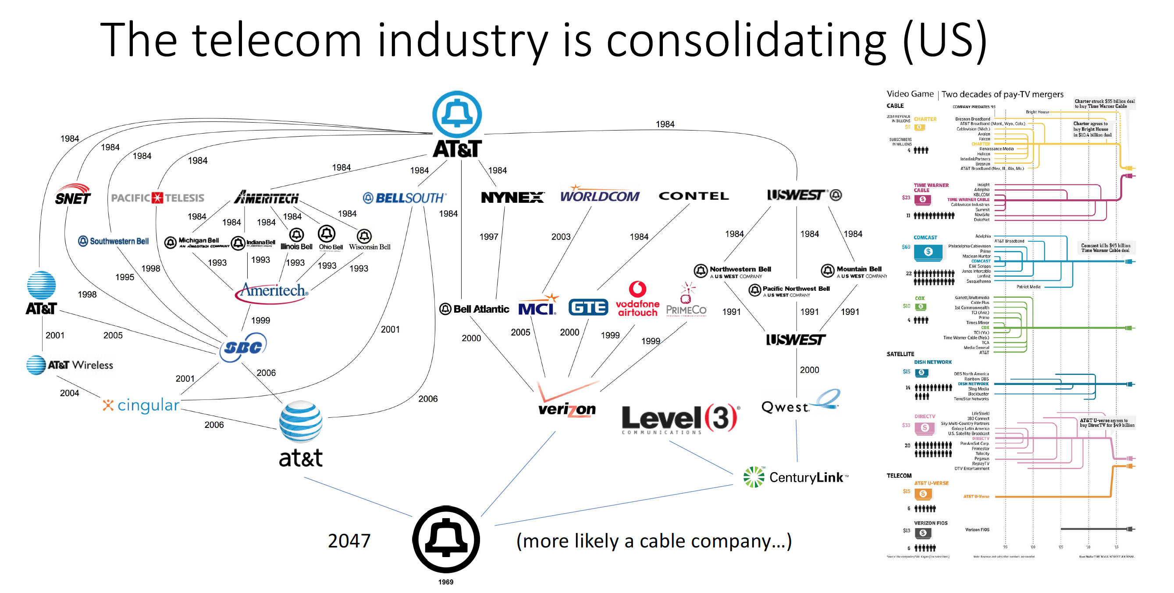
Let’s shift from 1998 to 2017
Competitive ISPs still exist
  but there is been a very large culling of the small to medium ISP sector, so the competitive pressure between ISPs is expressed in different ways
Henning Schulzerinne – IETF 100 Plenary

Slide 37
Let’s shift forward from 1998 to 2017
Carriage Prices have plunged
  Partly due to fibre optic evolution, partly due to market consolidation and economies of scale
  Unit prices for Internet access have fallen on a per Mbps scale
  Continual pressure both market-based and regulatory-based to further drop prices

Slide 38
Lessons Learned (1)
The rules of the Peering Game haven’t changed
  Peering works when the parties bring approximately equal value to the relationship
  Peering fails when one party relies on the other
  Peering is stable when neither party needs it more than the other
  Paradoxically, peering is at its most stable when neither party needs to peer with the other!
  At its heart, the peering game is still a game of bluff and leverage!

Slide 39
Lessons Learned (2)
Regulatory intervention often creates more harm then good
  This is a volume-based service enterprise where larger entities can access dramatically lower unit prices than smaller entities
  Regulatory intervention creates investment risk, where the normal market pressures are distorted by the regulatory tilt
  It creates disincentives for further capital investment in infrastructure by the major private actors in a market, leaving the space to under-capitalized and inefficient smaller operators
  This also creates perverse incentives to corrupt the regulatory structure

Slide 40
Lessons Learned (3)
Increased Competition does not necessarily result in increased market efficiency
  In a service activity that exhibits economies of scale, smaller providers will be unable to compete on price
  Artificially sustaining the continued existence of inefficient providers through regulatory protections leads to an inefficient market, with higher prices passed onto consumers

Slide 41
Today’s Internet
The ISP transit market is failing
  Rapid technology changes in fibre and silicon capability depress costs for new entrants
  Incumbents are forced to operate on low or negative margins to stay competitive on older technology platforms
  Incumbents form defensive cartels to collectively raise barriers to entry
  Regulatory stance typically favors incumbents over challengers

Slide 42
Today’s Internet
The rise and rise of Content Distribution Networks as specialized actors
  If you can bring valued content close to consumers then the role of Internet carriage is devalued – carriage is marginalised
  Which means that the levels of diversity and competition in carriage is less important to the overall Internet service market and its efficiency
To borrow another slide from 1998:

Slide 43
The Bottom Line
Continued operation of a strongly competitive diverse national ISP carriage market is probably the wrong answer.
The money is NOT in IP. Regulatory intervention at the IP level is stunningly dangerous to any national economy.
Intense IP provider aggregation is coming, but it may not matter as much any more. The largest revenue margins are in content service, not packet plumbing.

Slide 44
Today
Inter-ISP traffic exchange is a marginal activity – the obvious money lies in content distribution – which means ISP peering is no longer as important to the ISPs
Exchange Operators are strongly motivated to attract CDNs to their facilities in order to attract access ISPs to colocate in their premises
Access ISPs are strongly motivated to connect to an exchange point in order to secure access to CDNs, not to other ISPs
Today’s IXPs are little more than aggregate CDN access points

Slide 45
Tomorrow
Market actors tend avoid intermediaries if they can improve their position through bypassing the intermediary
So CDN operators are pushing further and closer to the edge with caches to sit inside the ISPs’ access network
Content delivery is moving inexorably closer to the consumer
The longer term role of ISPs and IXPs in this environment is very unclear at present

Slide 46
Audiens Cave
Much of this material is based on my direct experience in the context of the Australian environment and its evolution of the past 25 years, and my observations of similar trends in North America and Western Europe
But these paths differ both by region and in time:
  Infrastructure base
  Public and Private Investment profile
  Geography
  Regulation
  Consumer preferences
So I’m not sure how much of this is directly relevant to you – that’s something you need to work out for yourself!

Slide 47
Interested? Further Reading:
“The internet has been quietly rewired”
  https://qz.com/742474/how-streaming-video-changed-the-shape-of-the-internet/
“Interdomain Traffic”, Craig Labowitz
  https://jon.oberheide.org/files/sigcomm10-interdomain.pdf
“A Better Way to Organize the Internet: Content-Centric Networking” Glenn Edens, Glenn Scott
  https://spectrum.ieee.org/telecom/internet/a-better-way-to-organize-the-internet-contentcentric-networking

